Slide 1
Inequality
Inequality
J. Bradford DeLong
U.C. Berkeley, NBER, and WCEG
delong@econ.berkeley.edu
First Draft: 2016-10-17
Revised: 2020-03-19
github: <https://github.com/braddelong/public-files/blob/master/lecture-inequality.pptx>
pages: <https://www.icloud.com/pages/0n-VUHop4KJl67sTtqKPidlLA>
html: <http://www.bradford-delong.com/2016/10/inequality-brown-university-janus-forum.html>

Slide 2
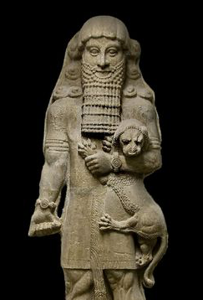

Inequality Has Ruled since Shortly After the Invention of Agriculture
Farming changes the game:
Once you have farms, you have large social groups
Bigger than, say, 100 at most
And you can’t run away…
Thugs with spears—and thugs with time to train…
Grifters with knowledge of the stars (which is, I must admit), useful…
And we were off and running…
1:30
Notes:
Gross, large scale inequality has been with us humans since at least shortly after the invention of agriculture.
Once you have farms, you see, you have the potential for large social groups—much larger than the 100 or so that seems to have been the size of our social groups back in the gatherer-hunter age. And once you have your farm, it becomes much more difficult to run away from unpleasant people.
Therefore, after the invention of agriculture, we get people who make a living as thugs-with-spears. They say: "give me a third of your crop or I will poke you with my spear". And you cannot move away before the harvest. And so they take a third of your crop.
And then, because they do not have to work growing their own crops, they train with their spears, and so become very good expert practitioners of coercive violence.
Then there are the other grifters who watch the stars and can predict the actions of the gods ans nature from their special knowledge. For example, they can tell you when the stars are so aligned that it will be time to start planting after the next full moon. They can tell you that you had better get the harvest in before the next new moon because the stars say that Father Winter is on its way to freeze the crops. And they are right often enough that you are happy to pay them a sixth of your crop.
Thus we were off and running: toward unequal, hierarchal societies...

Slide 3
Inequality Has Ruled: Ideological Legitimation
Gilgamesh in his element:
“Around the enclosed space that is Uruk he walks, mighty like the wild bull, head raised high. None with weapon might challenge him as rival. His men stand at attention, longing for his orders; but the old men of Uruk grouse that Gilgamesh has left no son to his father, for his arrogance has grown boundless…
William Muss-Arnolt, trans.: The Man Who Has Seen All Things <http://www.jasoncolavito.com/epic-of-gilgamesh.html>
2:00
Notes:
What happens when one thug with a spear meets another thug with a spear? It can get ugly. So sooner or later the thugs with spears organize themselves, with marked out and assigned territories. It still gets ugly among them. But it gets ugly less often. However, when it does get ugly it can get very ugly indeed: we have what we now call the social practice of "war".
Moreover, within the group of these expert practitioners of coercive violence—plus those who predict the actions of nature and the gods by watching the stars—there arises a problem: how they are going to distribute the crops that they have taken from the farmers at the point of the spear? Internal hierarchy develops among the elite. And, perhaps around the year -3000, these internal hierarchies begin coming to a very sharp point at the top.
The oldest thing that has survived and come down to us that can be called a story or a piece of literature is the ancient Mesopotamian document: _The Man Who Has Seen All Things_, what we call the _Epic of Gilgamesh_. Its protagonist is, well, Gilgamesh, portrayed holding a lion cub in the statue on the right. The epic describes Gilgamesh in his setting: king of the city of Uruk, in Mesopotamia. The statue shows how at least later generations remembered Gilgamesh's physique: buff, swoll, mighty-thewed, and does his face look wise, and perhaps even fair? The lion cub looks remarkably placid—perhaps drugged, or perhaps acknowledging that Gilgamesh is even lord of lions. Listen to the description:
>Around the enclosed space that is Uruk he walks, mighty like the wild bull, head raised high. None with weapon might challenge him as rival. His men stand at attention, longing for his orders; but the old men of Uruk grouse that Gilgamesh has left no son to his father, for his arrogance has grown boundless…

Slide 4
Authoritarian and Sexual Tyrant
Gilgamesh, in his element, continued:
“He has taken all their children, for is Gilgamesh not the shepherd of his people?
“Gilgamesh does not leave a daughter to her mother, nor the maiden to the warrior, nor the wife to her husband.
“Yet Gilgamesh is the magnificent and glorious shepherd of his people.
“The gods heard the people’s cry, and the gods of heaven beseeched the Lord of Uruk, Anu the god…”
3:15

Slide 5
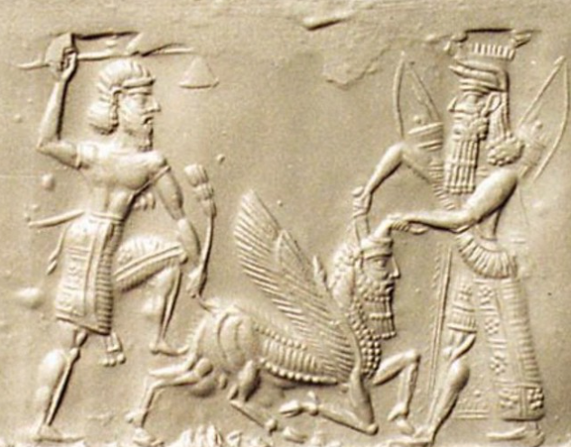
The First Male Bonding Buddy Story
The gods do respond:
The cries of the people of Uruk lead the gods to do something…
But the gods do not reform the institutions of the polity of Uruk…
Instead, they create a buddy for Gilgamesh: Enkidu
Gilgamesh and Enkidu fight, and then they bond, and then they become best friends, and then they have adventures and go on quests
By the end of the story Enkidu has died, the serpent has taken something immensely valuable away from humanity, and Gilgamesh has experienced personal growth: he is a much wiser—and much better—king
But he remains king: Uruk remains a polity of gross inequality
Gilgamesh and Enkidu slaying the Bull of Heaven
Neo-Assyrian, -800 ro -600
<www.bibleorigins.net/illustrationofGilgameshAndEnkidu.html>
1:15
Notes:
What the gods do is that they improve the lot of the people in Uruk by distracting Gilgamesh. They give him other things to do, so that he will leave the people of Uruk alone and not oppress them. They set in motion the first male-bonding buddy story.
What the gods do in response to the cries of the people of Uruk for them to do something is not to reform the institutions of the polity of Uruk or to smack Gilgamesh down. Instead, they create a buddy for Gilgamesh: Enkidu. Gilgamesh and Enkidu fight, and then they bond, and then they become best friends, and then they have adventures and go on quests
By the end of the story Enkidu has died, Gilgamesh has learned about how humanity survived the great worldwide flood, a barmaid has given him lessons in Epicurean philosophy, the serpent has taken something immensely valuable away from humanity, and Gilgamesh has experienced personal growth: he is a much wiser—and much better—king.
Read it. It is a great story.
But Gilgamesh remains king: Uruk remains a polity of gross inequality.

Slide 6
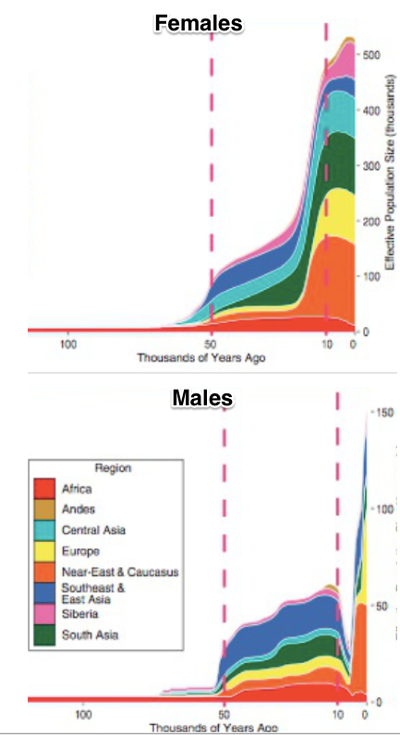
Inequality and Patriarchy
Agrarian age inequality is inscribed in our genes:
Everyone inherits their mitochondria from their mothers
Every male inherits his Y-chromosome from his father
From -5000 to -2000, a huge chunk of Y-chromosome lineages are not propagating
Polygyny for some—and non-matrimony for others
Persistence of (male) descent groups
What’s life like for women as this goes on?
https://logarithmichistory.wordpress.com/2015/09/27/the-patriarchal-age/
http://genome.cshlp.org/content/early/2015/03/13/gr.186684.114.full.pdf
4:00
Notes:
There is a very close and intimate connection in the agrarian age between gross inequality and high patriarchy. Agrarian age inequality is literally inscribed in our genes.
It is an elementary fact of our genetics that there is a small proportion of our genome—the mitochondrial DNA genome—that we inherit only from our mothers. Thus we can trace descent back through the exclusively female line, and by looking at the amount of mutations and genetic divergence in a human population today in that portion of the genome, determine the effective female population size of the human race back in the past all the way back to mitochondrial Eve: the woman who is the mother's mother's mother's... mother's mother's mother of us all.
And It is an elementary fact of our genetics that there is a small proportion of every male's genome—the y-chromosome genome—that we inherit only from our fathers. Thus we can trace descent of males back through the exclusively male line, and by looking at the amount of mutations and genetic divergence in a human population today in that portion of the genome, determine the effective male population size of the human race back in the past all the way back to y-chromosome Adam: the father who is our father's father's father's... father's father's father of us all.
When we do this, we find something going on between the years -5000 and -2000 according to our calendar. The effective female population size becomes much much much much larger than the effective male population size, and then they resume the rough equality that they had had before the year -5000 and since the year -2000. But in between, well, the overwhelming bulk of women are having daughters who have daughters... whose daughters' daughters' daughters are among us. A smaller percentage of men are. Only a small proportion of men breed, and then their sons breed and their sons breed, so that the chain is such that their sons'... son's sons are among us.
This is polygyny: one man, many wives—and lots of men with no wives and little sexual access to women. This is the Biblical Patriarch Jacob: 13 children with two wives and two concubines. Jacob and Leah's children were Reuben, Simeon, Levi, Judah Issachar, Zebulun, and Dina; Jacob and Rachel's children were Joseph and Benjamin; Jacob and Zilpah's children were Gad and Asher, and Jacob and Bilhah's children were Dan and Naphtali. And somewhere in the neighborhood there were three men—unnamed—who were without wives, and without children. Leah, Rachel, Zilpah, and Bilhah's mitochondrial DNA lineages were passed down. The three nameless men's y-chromosome lineages were not: only Jacob's was.
Maintaining polygyny for a number of generations requires great social pressure and great societal inequality among men. It also requires a great deal of subservience among women. Back in the age -5000 to -2000, women were, to a substantial degree, property: the property of their fathers, and then of those in the patriarchal polygynous network who gained control over them. And back in the age -5000 to -2000, a great many men were without resources‚ for the overwhelming majority of men would, if they had resources to deploy to attain any form of social power, would have chosen to use those resources to marry. And yet many of them could not do so
What was human life and human inequality like back in this patriarchal age? What brought it on? What made it come to an end?

Slide 7
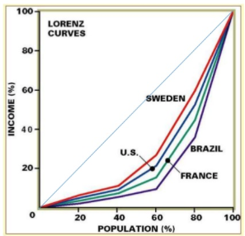
What Is the Gini Coefficient?
A number describing inequality—that I at least find hard to understand what it means:
Here are some facts to give you some intuition:
If the bottom 3/4 got 1/4 of the income and the top 1/4 the rest (evenly distributed), the Gini would be 0.5
If the bottom 2/3 got 1/3 of the income and the top 1/3 the rest (evenly distributed), the Gini would be 0.33
The Gini is income: not status. The 4M slaves in the U.S. in 1860 would have objected most strongly to claim that U.S. then no more unequal than Britain
If you were to think like a utilitarian—and assume that each doubling of income is equally valuable in a utilitarian sense—a move from a Gini of 0.5 to 0.33 would be like a 30% boost to everyone’s income
1:50
Notes:
A parenthesis: when you listen to a discussion of inequality, you may hear lots of references to something called the "Gini Coefficient". What is this Gini Coefficient?
It is a number describing and summarizing a society's inequality —a number that I find I have a very hard time grasping, a hard time understanding what saying "this society's Gini is X" really means. It is not intuitive to me.
Here are some facts to give you some intuition:
1. If the bottom 3/4 of a population got 1/4 of the income and the top 1/4 got the rest, and if income were evenly distributed within the bottom 3/4 and within the top 1/4, the Gini coefficient would be 0.5.
2. If the bottom 2/3 got 1/3 of the income and the top 1/3 got the rest, and if it were evenly distributed within the bottom 2/3 and within the top 1/3, the Gini would be 0.33.
The Gini is income, not status or power: the 4 million slaves in the United States in 1860 would have objected most strongly to claims that the United States was then no more unequal than Britain. Yet that is what the Gini coefficient calculated from the income distribution shows.
If you were to think like utilitarian, and assume that each doubling of income is equally valuable in a utilitarian sense, then a move from a Gini of 0.5 to 0.33 would be, in terms of its effects on total societal utility, like a 30% boost to everyone's income.

Slide 8
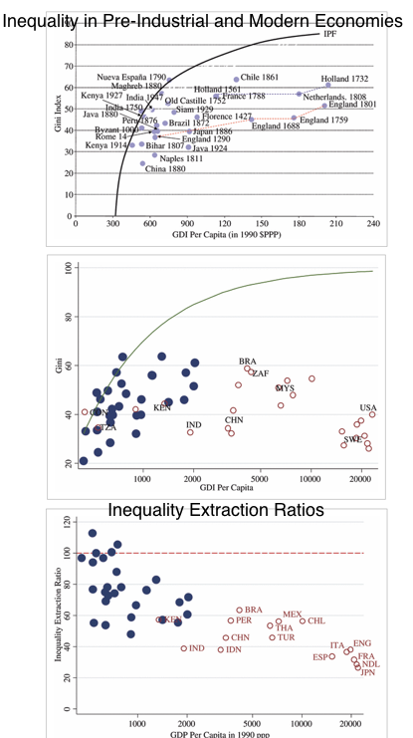
Agrarian Age Economies Look to Have Been About 80% as Unequal as They Could Have Possibly Been
Inequality in poor agrarian age economies cannot have been too great:
They are very poor…
Hence if income inequality is too great, hen poor women are too skinny to ovulate and poor children so malnourished as to have compromised immune systems
In which case they die, and so “decrease the surplus population”
And the society dies out—or becomes less unequal
<http://onlinelibrary.wiley.com/doi/10.1111/j.1468-0297.2010.02403.x/full>
2:00
Notes:
Agrarian age economies look to have been about 80% as unequal as they could have possibly been. Inequality in poor agrarian age economies cannot have been too great. Why not? Because they were very poor. Hence if income inequality was too great, then poor and working-class women would have been too skinny to ovulate and poor children so malnourished as to have compromised their immune systems. In that case they die, and so “decrease the surplus population”. And so the society dies out—or becomes less unequal.
Thus our modern societies are, typically, as unequal or more unequal than agrarian age societies.
But should this surprise us? Our rich today have enormous opportunities to spend their wealth on things that please and delight them. But back in the old days—well, consider Gilgamesh. 2/3 god and 1/3 man. Maginificent and glorious shepherd of his people. Yet his wealth could be used pretty much to eat meat, drink beer, ensure that the wool he wore was made soft. For him to even have cedarwood planks to use in construction for his royal apartments required a major military expedition, and the slaying of a monster.

Slide 9
But Is That the Right Way to Look at It?
Poor people living at subsistence must be under a lot of societal pressure:
To get people to give up enough of their crop that they know that they will be hungry all the time is difficult
To get people to give up enough of their crop that they know their children will be malnourished and crying is difficult
Counting value of goods when some of the people from whom surplus is being extracted are at the margin of subsistence may be the wrong thing to do
Moreover, there is more than an economic dimension to inequality
There is status group inequality
women
slaves
subordinate castes
2:30
Notes:
But is this valuing income and valuing the amount of resources people consume the right way to look at it?
Poor people living at subsistence back in agrarian age economies must have been under awful a lot of societal pressure in order for an unequal income distribution to have been maintained.
The poor were, after all, the producers: the farmers and the craftsman. Those who extracted surplus from them had no immediate place in the process of production from which they could divert the product. It was not that the poor worked for the rich on materials provided by the rich that the rich then sold before paying wages. It was that the farmers and the craftsmen did the work, by themselves, on their farms or in their shops.
The thugs-with-spears then had to tax it, or collect it in rent.
To get people to give up enough of their crop when they know that if they do so they will be hungry all the time—that is difficult.
To get people to give up enough of their crop when they know that if they do their children will be malnourished and crying all the time—that is difficult.
Counting and comparing commodity values when some of the people from whom surplus is being extracted are at the margin of subsistence is what we do. But consider that the poor back then had their minds concentrated on how awful it would be for them to allow extraction without attempting every expedient to prevent it. The societal power gradient is a separate thing from the economic gradient, and may be a different thing. So simply counting and valuing commodities may just the wrong thing to do if we want to understand what agrarian age inequality in near-subsistence poor cultures really meant.
Moreover, there is more than an economic dimension to inequality. There is status group inequality as well. People get assigned to subordinate groups: subordinated castes, slaves, women, people who in the eyes of society's hierarchy are at best equal to and may be worth less than cattle. How are these distinctions created, maintained, and enforced? And what does being on the bottom side of these distinctions mean for the life even of someone—even someone who is eating relatively well, and wearing soft wool, but at the dictate and by the grace of another? Cf.: Sally Hemings.

Slide 10
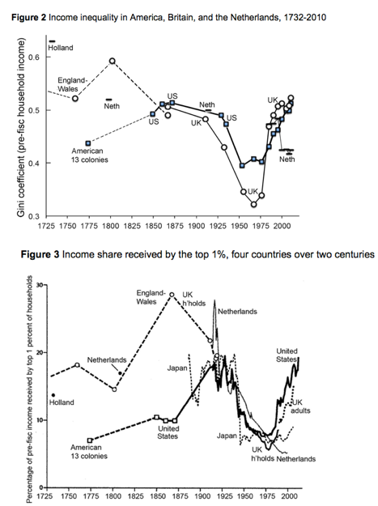
Shifts in American Inequality since 1725
Settler America initially a relatively not too unequal place:
As far as pre-industrial and early industrial economies are concerned
(For non-slaves) (and for non-women) (and for non-Indians)
Top 1% 8-10 times average, rather than 15-30 times average
Today in the U.S. top 1%—those households with incomes more than $500K/year—make 20 times average
First Gilded Age: rising inequality in the U.S., slightly falling in Europe
Age of Social Democracy
Second Gilded Age
<http://voxeu.org/article/american-growth-and-inequality-1700>
2:30
Notes:
Let me very briefly summarize the shifts in American inequality since 1725:
The America of the European settlers was initially, in the 1600s and 1700s, not too unequal a place, as far as agrarian age preindustrial and then early industrial economies were concerned.
Of course all of this is for white males, as pretty much the only people who fully counted. Slaves were unequal. Women were unequal. Amerindians—if they had survived the plagues and the wars and the forced migrations—were unequal. Even among white men, non-slaveholders in the slave south had very little societal power: If they ran their own farms, they had to sell their produce into a market in which slave-grown corn and slave-raised pigs were determining the prices that they could get. If they sought to work for others, they had to sell their labor into a market in which their potential employers' competitors would be using and driving their slaves with the whip, and thus pushing down the wages that their own employers could afford to pay.
All that said, the top one percent of white males in colonial and early federal America had maybe 8 to 10 times the average, rather than a perhaps more typical 15 to 30 times the average. (Today in the United States the top 1% of households—those households with income more than $500,000 a year—make 20 times the average.)
The coming of emancipation in 1863 and 1865 was a huge thing for economic and social equality. The coming of feminism, even early feminism, was a substantial thing for social equality if not for economic.
As far as economic equality and inequality are concerned, the post-Civil War to 1929 runup in inequality was very substantial. It changed the character of the country. Then the 1930s in the 1940s saw a great compression of wages, salaries, incomes, and wealth. After World War II the United States was, for white males, much more of a middle-class society than it had been in the First Gilded Age from 1890 to 1929.
But then the second Gilded Age began. Inequality has risen at what looks to be a historically unprecedented pace since the inauguration of Ronald Reagan in 1981. We now live in the high Second Gilded Age, with income and wealth inequality as great as or greater than it has even been before in America.

Slide 11
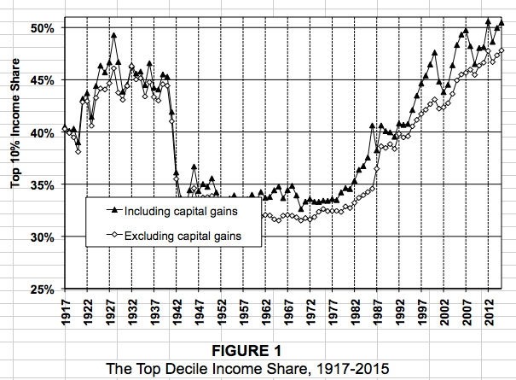
The Top-Tenth
The “tenth” are not a constant group: a quarter of people will spend at least two years in the top tenth…
These are taxpaying household units, from Piketty and Saez
2:30
Notes:
Here we see the income shares of the top tenth of Americans. These are taxpaying household units, as calculated by Thomas Piketty and Emmanuel Saez from United States Internal Revenue Service records. Now the top 10th is not a constant group: over their lives a quarter of people will spend at least two years in the top 10th. My wife and I did not hit the top 10th of household incomes until we were 28—but we have not been out of it since, and do not expect to be out of the top 10th as far as incomes are concerned until we hit our 70s, and then if we do fall out of the top 10th it will probably be because we have delayed realization of our capital gains on our assets.
Here we can clearly see the First Gilded Age, the Great Compression—in these data coming at the start of World War II—and then the 40 years of the-social democratic middle-class society. This last era was then followed by the post-Reagan inauguration coming of the second Gilded Age, and our attainment today of previously unseen levels of American inequality.
Note that in the later stages of the social-democratic era and throughout the coming of the Second Gilded Age, societal and economic equality has been increasing substantially along the dimensions of race and gender. Women make a lot more today then they did in the 1960s, and have much greater job opportunities. The gap at any particular income percentile between native-born whites on the one hand and African-Americans and Hispanic-Americans on the other has also shrunk substantially. It is the income percentiles, both within groups and for the country as a whole, that have pulled themselves much further apart.
These annual income numbers are not the income numbers we would really want to have for studying inequality. We would want inequality in life chances beforehand and in life outcomes afterwards, looking over lifespans as a whole. We do know that social and economic mobility within groups has fallen considerably since the 1960s, as well as the income gradient steepening massively.

Slide 12
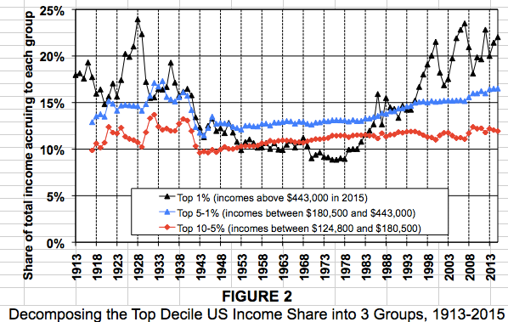
Dividing the Top-Tenth
The action within the top 10% is almost all in the top 1%
Think of it this way: the rest of us used to pay 10% of everything for the privilege of being bossed around by the top1%
Now we pay 20%. “Are we now getting our money’s worth?” is the natural question
2:50
Notes:
Here we see, in the Piketty-Saez dataset, the division of the top 10th into three groups: the top 1%, from the 1st to the 5th percentile, and from the 5th to the 10th percentile.
There is is very little action in the relative income share of the group between percentiles 5 and 10—what we might as well call our upper-middle-class. They tend to have gotten about 12% of income throughout the years since the end of World War I. That is about 2.4 times the average. Big movements in inequality have neither improved nor lessened their relative economic status and economic societal power over the past hundred years.
There is a little more action in what we might call the lower-upper-class: the people from percentile 1 to percentile 5. They received 15% of income—about 3.8 times average—back before World War II and they receive about 15 times today. They lost about 1/6 of their relative income position during the social democratic era.
The action within the top 10% is almost all in the top 1%: our upper class. Today the upper class receives about 22% of national income: a potential standard of living and a level of economic societal power 22 times the average. Back in the social democratic era they received only 10% of national income. And back before World War II, back in the First Gilded Age, they appear to have received about 16% of national income—
3/4 of their current share—save in the high boom and then bubble years of the Roaring 20s.
For our upper class of the top 1%, the years since the neoliberal era started, since the Second Gilded Age began with Ronald Reagan's inauguration, have been extraordinary years. Their relative and their absolute incomes and thus their societal power and their ability to command nature have grown at rates previously unprecedented for any upper class, anytime, any where. No wonder that you sometimes hear people talk about booms in the past 40 years! But that is not the average or of the typical experience.
One way to conceptualize what has happened in the Second Gilded Age is to note that the rest of us used to pay 10% for the privilege of being bossed around by the top 1%, who did indeed provide us with services, managerial and also technical and professional expertise-based, that the market has always valued very highly. Back then we paid 10%. Now we pay 22%. The natural questions to ask are then: Are we now getting our money's worth? Were we back then getting a major bargain by exploiting our rich?

Slide 13
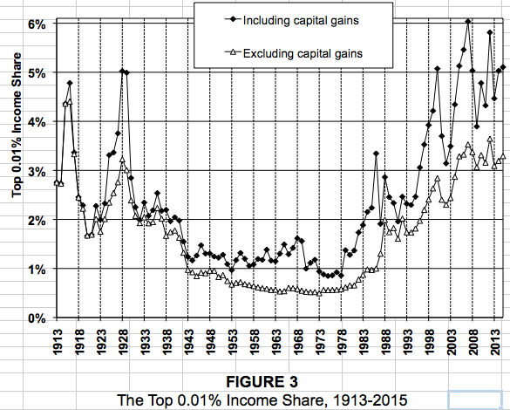
The Overclass
And the top 0.01%?
We pay 5 times as great a share of income now as in the 1970s for whatever they do. 15,000 households. $60 million year for each…
1:00
Notes:
And now we come to our overclass: the top 0.01%. These are 15,000 households in the United States of America. Their incomes average 60 million a year. Today, we pay five times as much to the overclass for them to perform the services for society that they do. What do the rest of us get in return? And how is it that it is this category of income that has been so greatly amplified in the Second Gilded age: the overclass share is now 2/3 greater than it was even back in the first Gilded Age.
5% of national income for 0.01% of the population means that these 15,000 households collectively have 500 times average income. Back in 1970 their counterparts had only 100 times average income. What has happened to our market economy and our system of property ownership to generate this change?

Slide 14

Six Sources of Rising Inequality—so Far
Six factors that matter:
The race between education and technology—upper middle class, the top 10% and above
Dissipative sectors: finance—upper class & overclass, the top 1% & 0.1%
Dissipative sectors: healthcare—upper class, top 1%
Collapse of worker bargaining power—pushes down the bottom 60%
Low-pressure economy—push down bottom 90%
Winner take all—upper class, top 1%
Three that do not:
“Bad trade deals”
Low-education immigration (save for its effects on earlier waves still not fully proficient in English)
Affirmative action (Arlie Hochschild)
2:00
Notes:
There have, at least so far, been six important sources and causes of rising inequality in the Second Gilded Age. And there are three things that are often blamed for rising inequality that are simply not so.
The six factors that matter are:
1. The race between education and technology, which education has lost over the past 40 years
2. The rise of a dissipative sector: finance. It consumes a huge amount of national income, yet it is hard to see what services it provides us that its much cheaper predecessor sector two generations ago did.
3. The rise of healthcare as a dissipative sector as well. Everyone believes we get enormous value from our health care sector. The problem is that our peer nations get the same value, or better value, from a health care sector that costs them one-third as much.
4. The collapse of worker bargaining power with the decline of the union movement
5. A low pressure high unemployment economy has been typical of the past 40 years
6. Changes in technology have created more winner-take-all markets, in which those who have or are thought to have special skills and expertise profit mightily.
The three factors that do not matter are:
1. "Bad trade deals".
2. Low-education immigration—save for the effects of low-skill immigration on earlier waves of immigrants still not fully proficient in English, with whom they do compete and whose wages they push down. But otherwise? Low-skill and low-education immigrants take jobs for which English proficiency is not a requirement, and native-born who would have taken those jobs otherwise find equivalently paid jobs for which English proficiency is a requirement.
3. Affirmative action—often blamed, but simply not a thing.

Slide 15
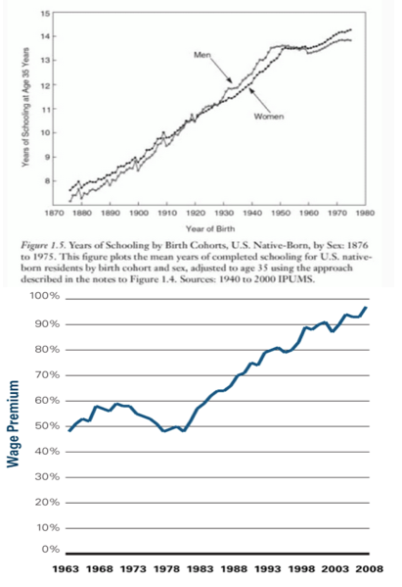
Sources of Rising Inequality I: The Race Between Education and Technology
America began charging for (public) colleges in the 1970s:
Initially a good-government move—college graduates were going to be rich, and making them pay seemed a progressive reform that took pressure off of state budgets
But as college became expensive, lots of people who ought to have gone to college didn’t
We lost the race between education and technology
And thus income inequality in the form of the college-high school wage premium leaped upward
This could be fixed—over generations
2:00
Notes:
The first important source of rising inequality is the race between education and technology.
Starting in 1970, you see, education begin to lose in its race with technology. That was when America begin charging for public colleges.
This was initially a good government move: college graduates are going to be rich, and making them pay something seemed a progressive reform that took pressure off of state budgets and promised to make America a less unequal and more fair place.
But it had unanticipated consequences.
As college became expensive, lots of people who ought to have gone to college did not. They feared the student loan burdens that they were taking on. They did not trust those who promised them that with college they could get a high-paying job that would easily allow them to pay off the loans. The shift to a low pressure economy with relatively high unemployment reinforced that unwillingness to go to college—even to relatively cheap public universities—on the part of those whose parents were not rich.
Thus we lost the race between education and technology. The skill requirements that technology imposed on the labor force kept growing. But the supply of workers did not keep pace. The growth rate of the number of workers who had a high level of formal education slowed way down. As a result, supply and demand pushed the wages of highly educated workers way up, and pushed the wages of workers who did not have get much education way down.
We could fix this with a commitment to offering free public college education. That would rebalance young people's life choices. But that would require political will. And inasmuch as the problem has taken generations to grow, it would take such a policy change generations to reverse it.

Slide 16
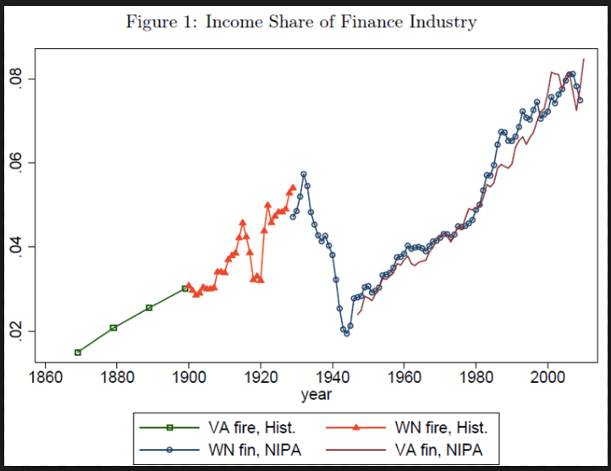
Sources of Rising Inequality II: Finance as a Dissipative Sector
The rise of superincomes in finance:
And in the related corporate over-structure paid as if they were financiers
This is a great puzzle:
People pay financiers voluntarily
Finance is much more competitive than in the 1960s
Finance much more steeply peaked than it was in the 1960s
Yet finance absorbed 3% of national income in the 1960s, and absorbs 9% of national income today
2:30
Notes:
A second source of rising inequality is the rise of American finance as a dissipative sector.
What do I mean by a "dissipative sector"? I mean a sector that collects huge rents off of the rest of the economy, and then distribute them to its workers in an extremely unequal way.
Back in the 1960s, American finance absorbed 3% of national income. In return for that 3%, it (1) greased all of our transactions as we bought and sold; (2) allowed us to invest for the future in the companies and real estate trusts of America; (3) tried to discover via market prices the values of investing in the future and then to transmit those values to the real economy, so savers and businesses could make their savings and investment decisions rationally, thus peering through the veil of time and ignorance; and (4) providing a degree of monitoring of corporate executives—executives thought to be performing poorly would see the prices of the stocks of the companies they ran fall, and then the scent of profit would trigger a proxy fight or an acquisition to try to get a more competent and more efficient management in place.
Today, however, we pay not 3% but 9% of national income for American finance.
Does it perform any of its four functions better than it did half a century ago? I see no evidence that it does—and I have looked, hard.
Moreover, the distribution of income from finance is much much more steeply peaked than it was in the 1960s: the coming of the Second Gilded Age has brought large scale financial superincomes with it.
Both parts of this are a puzzle: both the rise in the finance share of national income from 3% to 9%, and the increasing peakedness of the distribution of income within finance. Finance is much more competitive now than it was back in the 1960s. People pay financiers voluntarily. And yet I cannot help but feel that finance is extracting 6% of national income from the economy as a whole and distributing it to the overclass and to the upper class as some weird form of behavioral and informational economic rent.

Slide 17
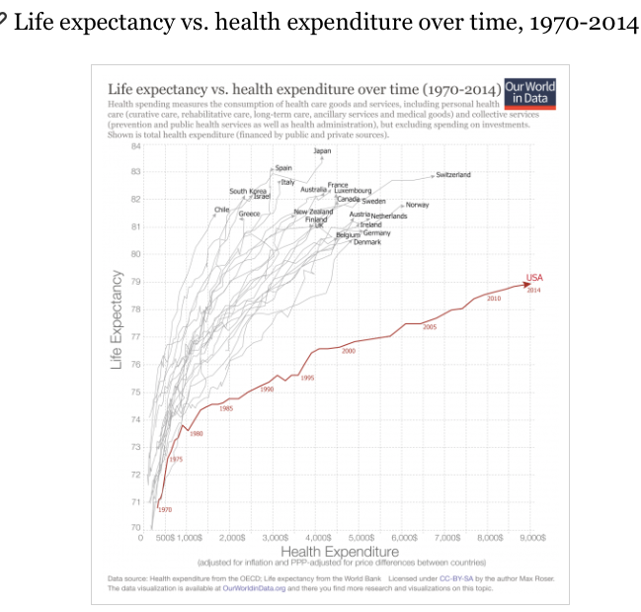
Sources of Rising Inequality III: Dissipative Sectors: Health Care
U.S. health care financing becomes dysfunctional starting with the Reagan administration:
Attempts at reform:
Failed 1993 HilaryCare effort blocked by Republicans
ObamaCare kneecapped by Republicans—but bent the rising cost curve to a considerable degree
Elsewhere in the world, doctors are well-paid—not superpaid, as are especially our specialists
And our care is uniquely wasteful: huge expenditures on the rich, inadequate care for the poor sick
And employer-sponsored insurance guarantees that many of the sick will be poor
Bottom line: WE SPEND THREE TIMES AS MUCH ON HEALTH CARE AS DO OUR PEER NATIONS, AND WE GET WORSE RESULTS
And the distribution of income within the health care sector is also steeply peaked (although not as steeply peaked as in finance)
2:45
Notes:
U.S. health care financing becomes dysfunctional starting with the Reagan administration, for a number of reasons that I do not have time to go into.
There were attempts at reform. The 1993 HilaryCare effort was blocked by Republicans: at the last moment Republican Senate minority leader and Kansas Senator Bob Dole decided he would rather go into full opposition to Bill Clinton to prepare to run for president in 1996 rather than have a substantial legislative accomplishment as the capstone to his Senate career. Then, after 17 wasted years, during which healthcare financing became increasingly dysfunctional, the Democrats passed Republican leader Mitt Romney's healthcare plan—and the Republicans then universally denounced it as the work of the devil, and set about trying to kneecap what had been their own plan. Even crippled, Obamacare did a great deal: it bent the rising cost curve of healthcare spending to a considerable degree, and significantly improved health coverage and access for Americans. But while it kept America's relative health care situation from getting worse, it did not repair the damage.
The result is our situation today. Elsewhere in the developed world, doctors are well-paid—not superpaid, as are especially our specialists. Elsewhere in the developed world, the sick are treated—not sent home for a check for insurance approval, and then told that their care has been denied by insurance. Thus as a result our care is both uniquely expensive and uniquely wasteful: huge expenditures on the rich, inadequate care for the poor sick. And our employer-sponsored insurance system guarantees that many of the sick will be poor
Bottom line: WE SPEND THREE TIMES AS MUCH ON HEALTH CARE AS DO OUR PEER NATIONS, AND WE GET WORSE RESULTS.
The distribution of income within the health care sector is also steeply peaked (although not as steeply peaked as in finance). Perhaps 5% of national income is dissipated in health care: an overpayment relative to what our peer nations accomplish, that is then transferred straight to the pockets of our upper class—although not, save for some pharmaceutical. hospital chain, and other health care executives, to the overclass.

Slide 18
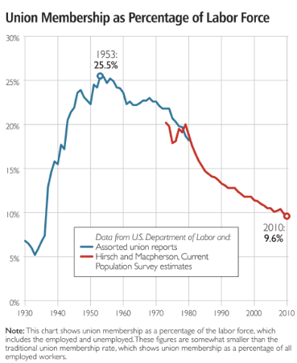
Sources of Rising Inequality IV: Collapse of Worker Bargaining Power
The war against the union movement:
“Monopoly” and “voice” face of the union movement
Strong monopsony employer element
Deunionization a significant negative for productivity
A transfer away from workers
To what extent is the fall in unionization the cause, and to what extent is it the effect of other economic changes—globalization, value chains, &c.—that have weakened worker bargaining power since 1980?
My take: globalization and wages not a thing in the 1980s and 1990s
Globalization and wages a huge regional thing in the first half of the 2000s—globalization boosts blue-collar wages in expanding regions (construction, investment goods) and lowers them in contracting ones (consumer manufacturing)
Globalization and a low-pressure economy a thing from 2008 on
But up until 2008, it is (a) regional, and (b) political and cultural
The majority of UAW members in Michigan voted for Ronald Reagan in 1980
They thought that they were anti-moocher first and pro-union second.
3:30
Notes:
The fourth of the important sources of rising inequality in the U.S. in the Second Gilded Age is the collapse of worker bargaining power. There has now been a 70-year-long war waged against the union movement and the Roosevelt Era labor relations settlement, primarily on the state but also, when Republicans have been in power since 1980, on the federal level. It has been very successful. And it has removed the countervailing worker-organization power that from 1935 into the 1980s checked the labor-market monopsony bargaining power of employers.
Unions have a hard time making the case for themselves in an economy committed to individualism and the market. The monopsony bargaining power that employers have when they deal with individual workers is for some reason harder to see than the monopoly power unions exercise. And unions have never been very good at tuning their strikes so that they motivate employers to settle and bargain while not inconveniencing the public.
And unions have not been good at selling themselves as important sources of knowledge and inforamation channels—as not so much "monopoly" as “voice” institutions, that make powerful contributions to higher productivity and better workplaces, which they do. Deunionization has been a significant negative for productivity. And deunionization has produced a significant transfer away from the true middle class and the working class to the upper middle class, the lower upper class, the upper class, and the overclass.
To what extent is the fall in unionization the cause, and to what extent is it the effect of other economic changes—globalization, value chains, &c.—that have weakened worker bargaining power since 1980? My take: globalization and wages were not a thing in the 1980s and 1990s. Competition then was more likely to be from high-wage than low-wage countries.
Globalization and wages became a huge regional thing in the first half of the 2000s—globalization boosted blue-collar wages in expanding regions though its financing of expanded construction and investment, while it lowered them in contracting regions that saw manufacuturing come under pressure. Of course, the major reason that manufacturing came under pressure was first the Reagan and then the Bush budget deficits: tax cuts for the rich that raise the value of the dollar have a powerful negative effect on manufacturing and on blue-collar wages in manufacturing-heavy regions.
Globalization and a low-pressure economy then became a thing from 2008 on.
But up until 2008, the decline in worker bargaining power is (a) regional, and (b) political and cultural. Ronald Reagan ran for office to, among other things, kneecap unions as part of the process of putting the moochers in their place. The majority of UAW members in Michigan voted for Ronald Reagan in 1980.
They thought that they were anti-moocher first and pro-union second—and they somehow overlooked the fact that the presidential candidate that they were voting for took them to be among the chief moochers.

Slide 19
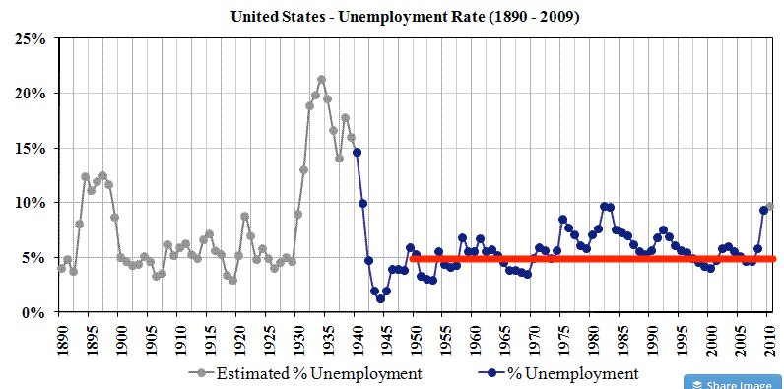
Sources of Rising Inequality V: Low-Pressure Economy
1:15
Notes:
And this brings us to the fifth of the important sources of rising inequality in America with the coming of the second Gilded Age: the low pressure economy.
Until the mid-1970s, the priority of economic policy was to maintain full employment, and control of inflation took a backseat. After 1978 and the installation of Paul Volcker as chair of the Federal Reserve, the priority of American economic policy was to control inflation, with maintaining high employment distinctly secondary.
Thus until the last few years the only other time since 1980 in which the unemployment rate has been less than 5% was a short period of time during the boom of the 1990s. And the policymaker who pushed unemployment that low in the late 1990s, Federal Reserve chair Alan Greenspan, found that his policy was opposed by most of his colleagues on the Federal Reserve Open Market Committee. He only managed to push it through and hold the course by strength of will.
In an economy in which people think it unlikely that they will easily be able to find another job as good as the one they currently have, there is going to be a lot of downward pressure on wages and upward pressure on profits over the generations.

Slide 20
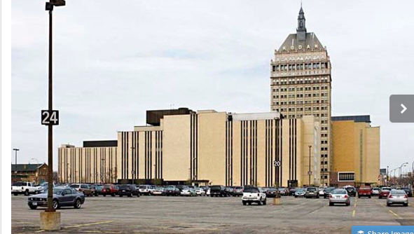

Sources of Rising Inequality VI: Winner Take All
Why do we now have more of a winner-take-all economy?:
Kodak vs. Google
Rochester vs. Mountain View
Middle-class prosperity for a region fueled by a critical mass of well-paying engineering and technical jobs
Winner-take-all billionaires and hundred millionaires…
1:45
Notes:
The last of our six important sources of rising inequality in America in the Second Gilded Age is the coming of the winner-take-all economy. People feel that is somehow related to the rise of information technology, and perhaps globalization, but the links remain obscure.
One of the high-tech industries of previous centuries was photography. George Eastman was a great engineer and innovator who build Kodak into a high-tech industrial powerhouse. Kodak was located primarily in the city of Rochester, New York. The fact that Kodak was located in Rochester generated middle-class prosperity for an entire region fueled by a critical mass of well-paying engineering and technical jobs employed in inventing, developing, and deploying Kodak's high-tech products into the American economy.
Kodak was not a winner-take-all operation.
By contrast, consider Google, which locates its headquarters in Mountain View, CA, in Silicon Valley.
Google has produced a few winner-take-all billionaires and a substantial number of 100 and 10 millionaires. It has provided very well-paying jobs for a relatively small number of engineers. It has had nothing like the regional reach of Kodak, in terms of triggering general prosperity.
Why not? Why now do we have more of a winner-take-all economy? Why are the rewards from intellectual property now so much more concentrated, while back before they were spread out over a larger number of engineers and technical professionals, who would use that intellectual property as they deployed it in their daily work?
It would be very valuable if we understood why our economy works this way. But I do not think that we know.

Slide 21
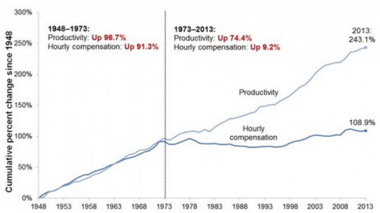
How Much Difference Does It Make?
The result of all six of these factors has been an enormous wedge between what has happened to average productivity in the American economy and what has happened to the incomes of hourly-wage workers
Thus the wages of the typical working class and lower middle class worker has stagnated for the past half-century
Moreover, the real wages of native-born white male hourly workers have fallen as minorities and women’s wages have grown because of reduced discrimination
And they are pissed
1:45
Notes:
How much difference do these six factors make? They make an enormous difference.
The result of all six of these factors has been to drive an enormous wedge over the past half century between what has happened to average productivity in the American economy and what has happened to the incomes of hourly-wage workers. Thus the wages of the typical working class and lower middle class worker have stagnated for the past half-century. Moreover, the real wages of native-born white male hourly workers have fallen, as minorities and women’s wages have grown because of reduced discrimination.
And so the American working and lower middle class are pissed: they think—not unreasonably—that America's elite has failed them, as they see increasing prosperity on the part of the upper middle class and those higher up that they are not sharing. In America, you are supposed to live better than your parents lived. Native-born white male working and lower middle class workers do not believe that they do.
Moreover, the true middle class—which has seen some income gains—and the upper middle class—which has done rather well—are pissed too. They see the lower upper class, the upper class, and the overclass, for whom the coming of the Second Gilded Age has been a bonanza. They know they have not shared in that prosperity. They feel that they deserve to. So they think America has failed them as well.
Even the lower upper class is envious of those who have won in the winner-take-all economy.
Only the upper class is happy. And the overclass is ecstatic: for it, the U.S. economy in the Second Gilded Age is the greatest thing the world has ever seen. And when you talk to them, you find them surprised that others do not see and do not agree on how great the American economy is.

Slide 22
What Happens Next?: Thomas Piketty’s Argument
“Capital” keeps the real rate of return at 5%:
In the Age of Social Democracy:
Population growth at 2%/year
Productivity growth at 2%/year
Conspicuous consumption/philanthropy/taxes at 3%/year
Means Old Capital gets eroded—the rich are entrepreneurs and enterprisers
In a Gilded Age
Population growth at 0.5%/year
Productivity growth at 1%/year
CC/P/T at 2%/year
Means Old Capital becomes dominant—the rich are, eventually, heirs and heiresses, and are very rich indeed with very large voices in politics
5:00
Notes:
So what is going to happen next with respect to income and wealth inequality?
The most interesting argument is the one made by Thomas Piketty, in his book _Capital in the 21st Century._ It is a long book. It is a rich book. Let me try to give you the two-minute summary for you to memorize so that you can fake having read it.
At the bottom of Piketty's argument, I think, is his belief that the business class—call it "capital"—has lots of political and economic power. They will almost invariably be able to use the power to keep the rate of profit on invested wealth, in whatever form, at about 5% per year. If it goes higher, investment and competition will push it down. If it goes lower, there will be institutional and other reforms to strengthen the rights of property to push it back up to the level that the business class thinks says "fair".
Now let's look at Old Money. Old Money receives that 5% real rate of return on its wealth. It then spends some of that on conspicuous consumption, and some on philanthropy. Some of it is then taxed away. In the age of social democracy, about 3% of all wealth each year is spent on conspicuous consumption and philanthropy and taxes, leaving 2% to add to the stock of Old Money.
Also, in the age of social democracy, that is up until the 1980s, the population of the global north grew at about 2% per year and productivity in the global north grew at about 2% per year, for a total rate of growth of the economy of 4% per year. With the stock of Old Money growing at 2% per year, while the economy was growing at 4% per year, as the years passed Old Money would become less salient in the economy.
Thus plutocrats would be few, and most of the superrich who existed would be those who have made their money recently through innovation, entrepreneurship, and creative destruction. They would view the future and they would view societal change as, by and large, good things.
Now let's consider what happened after 1980. Population growth slowed in the global north to more like 0.5% per year. Productivity growth slowed as well, to 1% per year or so. And taxes on the rich were reduced in order to incentivize the "job creators". Philanthropy became a smaller proportion of total wealth as the "greed is good" philosophy spread through the overclass. In the Second Gilded Age, with conspicuous consumption and philanthropy and taxes at 2% per year, and with the rate of profit at 5% per year, Old Money is growing at 3% per year. But the economy is growing at only 1.5% per year.
So every year Old Money becomes more and more salient in the economy.
Plutocrats become abundant. Increasing numbers of the superrich are those who have inherited their money. They are hostile to creative destruction and societal change: after all, they think they will be the ones who will be creatively destroyed. It was their ancestors who had surfed the waves of change, not themselves. With the increasing economic salience of Old Money comes increasing the political power of wealth, and increasing fear of the future.
Now here is the kicker: according to Piketty's simulations, this process is ongoing. It is not even half complete. So, in Piketty's estimation, we need to do a lot to change things and put Old Money on a downward trajectory in its salience. If not, we then have to look forward to a bigger and more vicious intensification of the Second Gilded Age.

Slide 23
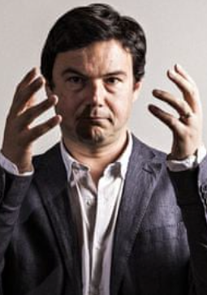
Criticisms of Piketty’s Argument
There are many criticisms of Piketty’s argument:
Can “capital” keep the real rate of return at 5%?
You would think that more capital would compete with itself for the services of workers to operate it, and so the rate of profit would fall…
What Keynes called “the euthanasia of the rentier”
More a story about Europe than about America
Europe is the place with ZPG
Europe is the place with less dynamic growth and less creative destruction
America’s rich are overwhelmingly entrepreneurs and superincome earners—not (or at least not yet) heirs and heiresses (but Waltons, Kochs, Trump)
3:00
Notes:
There have been many criticisms of Piketty's argument. I think most of them have been made in bad faith, by people who have not read or did not understand the book because they did not want to understand it—or by people who have employers or patrons that they want to please.
But there are some real criticisms. Let me run through two them:
First, can “capital” keep the real rate of profit at 5%? You would think that more capital would compete with itself for the services of workers to operate it, and so the rate of profit would fall. You would think that in a low interest rate economy you would see what Keynes called “the euthanasia of the rentier”—that Old Money seeking safety for its wealth would be forced into low-yielding government bonds that paid little, and so fail to get the 5% rate of profit. Old Money would decline in salience.
But if you look at the portfolios of Old Money these days, you find they do not seek safety. Sometimes they are well diversified. Sometimes they are concentrated in their historical or ancestral industries and firms. In the first case, the fact that even well diversified risk bearing is rewarded in our modern economy means that the return on Old Money is indeed the 5% rate of profit rather than the -1% real safe rate of interest on government bonds.
In the second case, the fact that the portfolios of Old Money are not diversified means that many of them suffer great losses because they are on the downside of creative destruction, but an equal amount of Old Money experiences windfall gains. Old Money those churns itself. Some of the ancestral names drop out of the plutocracy. But their wealth is transferred to those of Old Money who were lucky in their undiversified investments, and the salience of Old Money continues to grow.
Thus I regard this criticism as largely off-base.
Second, isn't this more a story about Europe than about America? Europe is the place with ZPG. Europe is the place with less dynamic growth and less creative destruction. America’s rich are overwhelmingly entrepreneurs and superincome earners—not heirs and heiresses.
But considerthe Waltons, the Kochs, Donald Trump himself. Piketty may be painting a picture of western Europe's present, but he is also painting a picture of America's future.
Thus I think this criticism is off base as well.
Piketty's argument looks reasonably strong to me.

Slide 24
Inequality and Growth: Big-Picture Evidence?
There is basically no pattern:
No pattern—either in the United States or elsewhere
Growth was fastest in the 1940s, 50s, and 60s in which income inequality was low
Growth was lowest in the 1970s (low), 1980s (low but rising), and 2000s (high)
Growth had a recovery in the 1990s (moderate but rising)
Growth was fast in the 1920s (high)
But the 1930s were a disaster…
Think that redistributing income either way is going to unleash growth, and you are mistaken
In which case why not do the utilitarian thing?
2:30
Notes:
There is one very common critique you see here in the global north and elsewhere about proposals to redistribute or to pre-distribute income and wealth in order to make society more equal: it is that any such move would wind up crippling economic growth.
The underlying idea is this: the rich need to be offered low taxes and have a high rate of profits on their creative, entrepreneurial, and investment activities in order to incentivize them to undertake the innovation and creative destruction that creates economic growth, rather than kick back on their sailboats drinking margaritas. Moreover, the work effort of the poor will be very low if life when you are unemployed or cannot hold a stable job is "too easy".
But on a macro scale there is no evidence at all that this kind of thing is true.
Across the decades, we see no pattern, either in the United States or elsewhere, with respect to any relationship between growth on the one hand and inequality and the amount of redistribution on the other.
America's growth was fastest in the 1940s and 1950s and 1960s, in which income inequality was low and redistribution through progressive taxes was relatively intense. Thereafter growth was lowest in the 1970s, when income inequality was low. It was second lowest in the 1980s, when income inequality was low but rising. It was also low in the 2000s, when income inequality was high. Growth had a recovery in the 1990s, and back then income inequality was moderate but rising.
Earlier, growth was fast in the 1920s when income inequality was high. But the 1930s, in which income inequality was also high, were a disaster.
Thinking that redistributing income either way is going to unleash a boom that will carry us to previously unseen heights of prosperity is simply wrong. There is no strong reason to believe that the government redistributing less will incentivize job creators and innovators to do their work better. There is no strong reason to believe that a government redistributing more will provide the poor with the resources to boost their investment in education and so unleash a boom.
My conclusion from this is in the end: why not do the utilitarian thing? Since there is no reason to believe that the amount of redistribution either retards or speeds growth significantly, why not look at the effect of the rise and fall of income inequality on people's happiness, and shape policy accordingly?

Slide 25
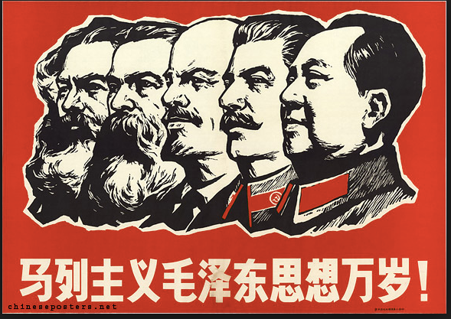
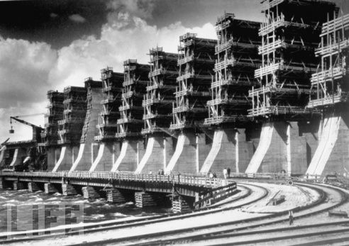
Except for the Experience of Really Existing Socialism…
Its form of economic “equality” was poisonous for growth and prosperity:
High Stalinist central planning
Marx’s suspicion of markets as surplus-extraction devices
Hence, the communists said, we won’t have any
We will reproduce the Rathenau-Ludendorff World War I Imperial German war economy
Communes, economies of scale, GOSPLAN, etc.
Effect: you throw away a five-fold amplification of productivity by eschewing the market
2:15
Notes:
There is one set of egalitarian and equalizing policies for which what I said on the previous slide is false: there is an extraordinary correlation between more redistribution and lower growth when the redistribution takes the form of really existing socialism as we saw it in the countries behind the Iron Curtain between 1917 and 1991. Stalinist or Maoist redistribution is absolutely poisonous.
It was associated, you see, with Stalinist central planning. High Stalinist central planning was generated by Marx's grave suspicion of markets. He saw them as surplus extraction devices alone, and not as societal calculating mechanisms for crowdsourcing solutions to social problems.
Hence, the communists said, because we are suspicious of markets we will not have any. We will, instead, run the economy by reproducing the Rathenau-Ludendorff World War I imperial German war economy. We will have agricultural communes and collective farms. We will build the largest possible factories so they have enormous economies of scale. We will have a large bureaucracy to tell people what they will produce, how, and for whom. Etc.
The net effect of this was to throw away 80% of the potential wealth of the societies behind the Iron Curtain. Their central planning systems were extraordinarily inefficient—so inefficient I can hardly believe it.
And it may well be that they did not produce very equal societies either. Yes, consumption inequality was relatively low. But, in a manner analogous to what was going on in the agrarian age, this was because society was poor. There were a lot of social status and power differences—and a lot of social pressure exerted to create and maintain the inequality in income and material wealth that existed—back under really existing socialism.

Slide 26
What Happens Next?
The “leaky bucket”:
Which way does the bucket travel?
Social democracy reduces the incentives of the rich and non-rich to work?
Higher inequality gives the rich more power and more of a stake in rent-seeking?
Who is creatively destroyed by creative destruction?
How much does the bucket leak?
2:15
Notes:
What happens next with respect to income and wealth equality? What happens next is on our hands.
Two generations ago Brookings Institution economist Art Okun set out the metaphor of the "leaky bucket": the government can transfer water from the deep pool of the rich to the shallow pool of the poor, but the bucket is leaky. If the bucket were completely leaky, so that all it did was reduce the depth of the pool of the rich, there would be no point to redistribution: it would simply be a losing game. If the bucket were not leaking at all, so that every drop taken out of the rich's pool was transferred to the poor's, you would want to do a great deal of redistribution. How much redistribution you want to do thus depends on how leaky the bucket is: how much do the institutions and policies of social democracy reduce the incentives of the non-rich and rich to work, and so reduce the size of the total economic pie? That was what Arthur Okun thought the proper size of redistribution, the social insurance state, and social democracy depended on.
But it has never been clear to me that the bucket is leaky. Or, perhaps, what I should say is that perhaps the bucket is leaking the other way. Does social democracy reduce the incentives of the non-rich to work and of the rich to engage in their "job creating" innovation? Or does the absence of social democracy and higher inequality give the rich more power and more of a stake in rent seeking? Do the rich actually want economic growth, with the creative destruction it brings? Who after all is destroyed by creative destruction?
Isn't there at least a stronger case for redistribution to curb the power of rent-seekers and so boost growth as opposed to the case against redistribution on the grounds that it erodes incentives? Here I wish we had more data. Here I think that all we have had is ideology. And I think that Okun's metaphor of the leaky bucket plays into one particular pro-plutocratic strain of ideology.
We seek equitable growth, and we have no reason to presume that even the growth part is encouraged by inequality and plutocracy.

Slide 27
What Should We Aim For?
What does a good society do?:
Democratic politics decides on distribution, and then business of economists to maximize production—boost average incomes…
The utilitarian view: inequalities “justified” when they lead to a positive average percentage change in incomes…
Rawlsian: inequalities “justified” only when they lead to a better life for the worst off…
Inequalities justified when they reward the “worthy”…
Inequalities justified when they allow for philosophy…
Inequalities justified when they are the result of a fair system…
1:30
Notes:
And then there are the philosophical questions: What should we aim for? What does a good society do?
Should we say that the key is to have democratic politics, and then let democratic politics decide on distributional questions? In that case it would then be the business of economists to maximize production to boost average incomes—and economists should then leave distributional questions alone to the philosophers and the political scientists.
Should we go for something like a utilitarian view, in which inequalities are justified when they lead to a positive average percentage change in income? In that case our social welfare function would be something like the geometric mean of incomes or consumption. Or should we be Rawlsian? In a Rawlsian framework, inequalities are justified only when they lead to a better life for the worst off.
Then there are people who think inequalities are justified when they reward the worthy, for some definition of worthy. Then we have the people—Aristotle—who think that inequalities are justified when they allow for philosophy. And then there are those who think that inequalities are justified when they are the result of a "fair" system. But what could a "fair" system possibly be?

Slide 28
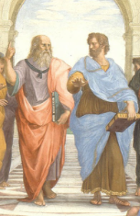
What Is This “Fair”?
The opening of Plato’s Republic:
Sokrates: "Well said, Kephalos; but as concerning justice, what is it?"
Kephalos: "To speak the truth and to pay your debts.”
The whole point of the opening of Plato’s Republic is that acting fairly—not cheating or stealing from people—does not by itself justice make.
But it is an essential part: people need to believe that they are neither cheaters nor cheated…
1:00
Notes:
In the opening of Plato's _Republic_, Sokrates says: "Well said, Kephalos, but as concerning justice, what is it?" The aged Kephalos replies: "To speak the truth and to pay your debts". But the whole point of the opening of Plato's _Republic_ is that acting _fairly_—not cheating or stealing from people—does not itself justice make. Nevertheless, fairness and acting fairly is an essential part of distributive justice. People need to believe that they are neither cheaters nor being cheated in the distribution of the good things.
Thus a good society is not just one that balances off inequality in distribution on the one hand against faster growth on the other. A good society is one in which the distribution of things is perceived to be _fair_. So one has to not only treat equals equally, one has to treat unequals unequally—and in a proper way. And this gets us into a thorny thicket of issues that I associate with early 20th century Hungarian-Jewish political economist Karl Polanyi.
But that is another lecture.

Slide 29
Notes, etc.…

Slide 30
Scratch…
Lecture: Inequality:
<https://github.com/braddelong/public-files/blob/master/lecture-inequality.pptx> <https://www.icloud.com/pages/0n-VUHop4KJl67sTtqKPidlLA> <http://www.bradford-delong.com/2016/10/inequality-brown-university-janus-forum.html>
History of Economic Growth Course: <https://github.com/braddelong/public-files/blob/master/econ-135-lecture-16.pptx> <https://www.icloud.com/keynote/0ibXJp1yUuOQLzQyCIUBhteGw>
Inequality: Brown Forum 2016: <https://www.icloud.com/keynote/0gIuwcJ_jAF0MtGozXgE7_95Q> <https://www.icloud.com/pages/0n-VUHop4KJl67sTtqKPidlLA> <http://www.bradford-delong.com/2016/10/inequality-brown-university-janus-forum.html>
210a Inequality: <https://www.icloud.com/keynote/0LvoKeQzg11t3SWw7NbOyYONA>
Inequality: Kaldor and Piketty Facts: <https://www.icloud.com/keynote/08pKBPWs0ZRbvkEuMEO8Bn-SA>
Econ 210a: Comparative Development and Underdevelopment: <https://www.icloud.com/keynote/0021dZ3X9btGL8HmUfimCwApA>
Globalization and Inequality (Stanford Panel 2017): <https://www.icloud.com/keynote/0a1YIQGu-i9__uHwnHA0thhTg> <https://www.icloud.com/pages/0_H9kCtNY6cZglaYpa4IRw2pQ.html>
Growing International Inequality: <key: https://www.icloud.com/keynote/03Ou4GJp-SrwWPP59FCv4P0TQ>
Within America Inequality: < https://www.icloud.com/keynote/0E0BFiZibqBqeow95Ktpwh6aA>
Global Inequality: <https://www.icloud.com/keynote/0q7z3YB0lNBUyqHcoi5MVVYuQ>
Inequality & My Brilliant Career: <https://www.icloud.com/keynote/07SeQDjYar1AKLhIUQGLDhVig>

